Slide 1
Functions and an
Introduction to Recursion
Chapter 6

Slide 2
Learning Outcomes
Construct programs modularly from functions
Use common math functions in C++ Standard Library
Create functions with multiple parameters
Understand the mechanisms for passing information between functions and returning results
Understand how the function call/return mechanism is supported by the function call stack and activation records
Understand the locality of the variables
Write and use recursive functions (functions that call themselves)

Slide 3
Program Components in C++
C++ Standard library
  Common mathematical calculations
  String manipulations
  Character manipulations
  Input/Output
  Error checking
  …
Why modularizing a program with functions
  More manageable ( construct programs from small, simple pieces)
  Reusable (using existing functions as building blocks to create new programs)
  Avoid repeating code
  Easier to debug and maintain

Slide 4
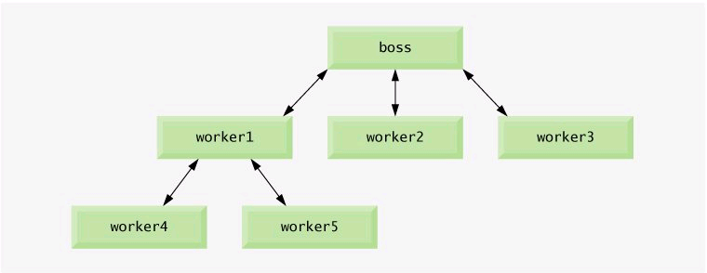
Hierarchical Boss Function/Worker Function Relationship

Slide 5
Math Library Functions
#include <cmath>
Function | Description | Example
ceil(x) | rounds x to the smallest integer not less than x | ceil(9.2) is 10
cos(x) | cosine of x | cos(0.0) is 1.0
exp(x) | exponential function e^{x} | exp(1.0) is 2.71828
fabs(x) | absolute value of x | fabs(-5.1) is 5.1
floor(x) | round x to the largest integer not greater than x | floor(-9.8) is -10.0
fmod(x, y) | remainder of x/y as a floating-point number | fmod(2.6, 1.2) is 0.2
log(x) | logarithm of x (base e) | log(2.718282) is 1.0
log10(x) | logarithm of x (base 10) | log10(10.0) is 1.0
pow(x, y) | x raised to power y x^{y} | pow(2, 7) is 128
sqrt(x) | square root of x | sqrt(9.0) is 3.0

Slide 6
Function Definitions with Multiple Parameters
int maximum(int x, int y, int z)
{
int maximumValue = x;
if(y > maximumValue)
maximumValue = y;
if (z > maximumValue)
maximumValue = z;
return maximumValue;
}

Slide 7
Function Prototypes and Function Signatures
Function prototypes
  Tells the compiler the name of a function
  The type of data returned by the function
  The number of parameters expected
  The type of each parameter
  The order of the parameters
  Obtained using #include preprocessor directive
  Can be omitted if functions are defined before they are used (function header acts as function prototype)
  Always provide function prototypes
    Avoid tying the code to the order in which functions are defined
Function signatures
  The name of the types of its arguments
  Does not specify return type
  Must have unique signature in the same scope

Slide 8
Argument Coercion
Forcing arguments to the appropriate types specified by the parameter declarations
  Function arguments can be promoted by the compiler
  Converting values to lower fundamental types can result in incorrect results
    only through explicitly assigning the value to a variable of lower type or using a cast operator.
Promotion rules
  Indicate how to convert between types without losing data
  Apply to mixed-type expressions
    Promote each value to the highest type in the expression

Slide 9
Promotion Hierarchy for Fundamental Data Types
Data type
long double
double
float
unsigned long int
long int
unsigned int
int
unsigned short int
short int
unsigned char
char
bool

Slide 10
C++ Standard Library Header Files
<iostream> | <iomanip> | <cmath>
<cstdlib> | <ctime> | <vector>
<deque> | <list> | <queue>
<stack> | <map> | <set>
<bitset> | <cctype> | <cstring>
<typeinfo> | <exception> | <memory>
<fstream> | <string> | <sstream>
<functional> | <iterator> | <algorithm>
<cassert> | <cstdio> | <limits>
<utility> | ……

Slide 11
Random Number Generator
#include <cstdlib>
rand()
  Generates a random integer between 0 and RAND_MAX
  RAND_MAX is compiler dependent
    GNU C++ (214748647 )
    Visual studio (32767)
  Every number between 0 and RAND_MAX has an equal chance of being chosen
srand(seed)
  Produce different sequence of random numbers for each execution of the program
  seed is an unsigned integer (0 – 04294967295)
  To randomize w/o having to enter a seed each time
    srand(time(0))
    time(0) returns the current time as the number of seconds since 01-01-1970.
    #include <ctime>

Slide 12
Cont’
Common programming Errors
  Calling function srand more than once in a program restarts the pseudorandom number sequence and can affect the randomness of the numbers produced by rand.
  Using srand in place of rand to attempt to generate random numbers is a compilation error—function srand does not return a value.

Slide 13
Rolling a Six-sided Die
Seed the random number generator
Initialize f1, f2, f3, f4, f5 and f6
Iterate for 6 million times
let face be a random number between 1 and 6
case (face)
case 1:
Increment f1
case 2:
Increment f2
case 3:
Increment f3
case 4:
Increment f4
case 5:
Increment f5
case 6:
Increment f6
face = 1+ rand()%6

Slide 14
Generalized Scaling and Shifting of Random Numbers
number = shiftingValue + rand()% scalingFactor
first number in the desired range
Width of the desired range

Slide 15
Game of Craps
Seed the random number generator using current time
Roll the dice
If the sum of dices is either 7 or 11
Player wins and set game status to “WON”
Else if the sum of dices is 2, 3 or 12
Player loses and set game status to “LOST”
Else
Let mypoint be the sum of dices
Continue and set game status to “CONTINUE”
While game status is still “CONTINUE”
roll the dice
if sum of dices matches with mypoint
Player wins and break out the loop
else if sum of dices is 7
Player loses and break out the loop
else
continue to next iteration
If game status is “WON”
Print out the winning message
If game status is “LOST”
Print out the losing message

Slide 16
User-Defined Type: Enumeration
enum Months{JAN=1, FEB, MAR, APR, MAY, JUN, JUL, AUG,SEP,OCT, NOV, DEC};
enum Status{CONTINUE, WON, LOST};
Type Name
Start at 0 by default
Use only uppercase letters in enumeration constants
Using enumeration make programs clearer and more maintainable.
Assigning the integer equivalent of an enumeration to a variable of enumeration type is a compilation error.

Slide 17
Attributes of An Identifier
Each identifier has several attributes
  Name, type, size and value
  Also storage class, scope and linkage
C++ provides five storage-class specifiers:
  auto, register, extern, mutable and static
Identifier’s storage class
  Determines the period during which that identifier exists in memory
Identifier’s scope
  Determines where the identifier can be referenced in a program
Identifier’s linkage
  Determines whether an identifier is known only in the source file where it is declared or across multiple files that are compiled, then linked together
An identifier’s storage-class specifier helps determine its storage class and linkage

Slide 18
Automatic Storage Class and
Principle of Least Privilege
Automatic storage class
  Declared with keywords auto and register
  Automatic variables
    Created when program execution enters block in which they are defined
    Exist while the block is active
    Destroyed when the program exits the block
    Means of conserving memory
  Only local variables and parameters can be of automatic storage class
Principle of least privilege
  Code should be granted only the amount of privilege and access that it needs to accomplish its designated task, but no more.
Notes:
Why should we have variables stored in memory and accessible when they are not needed?

Slide 19
auto and register Storage Class Specifier
Storage-class specifier auto
  Explicitly declares variables of automatic storage class
  Local variables are of automatic storage class by default
    So keyword auto rarely is used
Storage-class specifier register
  Data in the machine-language version of a program is normally loaded into registers for calculations and other processing
    Compiler tries to store register storage class variables in a register
  The compiler might ignore register declarations
    May not be sufficient registers for the compiler to use
  Often, register is unnecessary. (compiler will place frequently used variable in registers)
Every identifier has only one storage class specifier
  E.g. if you include register, do not also include auto.
Notes:
Today’s optimizing compilers are capable of recognizing frequently used variables and can decide to place them in registers without needing a register declaration from the programmer.

Slide 20
Performance Tip
The storage-class specifier register can be placed before an automatic variable declaration to suggest that the compiler maintain the variable in one of the computer’s high-speed hardware registers rather than in memory. If intensely used variables such as counters or totals are maintained in hardware registers, the overhead of repeatedly loading the variables from memory into the registers and storing the results back into memory is eliminated.

Slide 21
Static Storage Class
Declared with keywords extern or static
Static-storage-class variables
  Exist from the point at which the program begins execution
  Initialized once when their declarations are encountered
  Last for the duration of the program
Static-storage-class functions
  The name of the function exists when the program begins execution, just as for all other functions
However, even though the variables and the function names exist from the start of program execution, this does not mean that these identifiers can be used throughout the program. (e.g, a local variable might be static)

Slide 22
Cont’
Two types of identifiers with static storage class
  External identifiers (global variables and global function names)
  Local static variables
    Known only in the function in which they are declared
    Retain their values when the function returns to its caller
    Initialized to zero is not explicitly initialized
Global variables
  Created by placing variable declarations outside any class or function definition
  Retain their values throughout the execution of the program
  Can be referenced by any function that follows their declarations or definitions in the source file
  Principle of least privilege tells us to avoid using global variables.

Slide 23
Extern Storage Class
Extern keyword is used to specify that the variable is declared is in a different file
  Use to declare variables of global scope in C++ projects
  Compiler will not allocate memory for the variable when the keyword is used
If a declaration for an identifier exists at file scope, any extern declaration of the same identifier found within a block refers to the same object. If no other declaration for the identifier exists at file scope, the identifier has external linkage
C++ restricts the use of extern storage class specifier to the names of objects or functions. An extern declaration cannot appear in class scope.
Prone to wrong external linking

Slide 24
Scope Rules
Scope
  Portion of the program where an identifier can be used
  Four main scopes for an identifier
    Global namespace scope
    Block/Local scope
    Function scope
    Function-prototype scope

Slide 25
Scope Rules (cont’)
Block scope
  Identifiers declared inside a block have block scope
    Block scope begins at the identifier’s declaration
    Block scope ends at the terminating right brace (}) of the block in which the identifier is declared
  Local variables and function parameters have block scope
    The function body is their block
  Any block can contain variable declarations
  Identifiers in an outer block can be “hidden” when a nested block has a local identifier with the same name (avoid duplicating names)
  Local variables declared static still have block scope, even though they exist from the time the program begins execution
    Storage duration does not affect the scope of an identifier

Slide 26
Scope Rules (Cont’)
Global namespace scope (or file scope)
  For an identifier declared outside any function or class
    Such an identifier is “known” in all functions from the point at which it is declared until the end of the file
  Global variables, function definitions and function prototypes placed outside a function all have file scope
Other scopes
  Class scope
  Namespace scope

Slide 27
Scoping Example
#include <iostream>
using namespace std;
void useLocal(); //function prototype
void useStaticLocal(); // function prototype
void useGlobal(); //function prototypte
int x = 1; //global variable
int main()
{
int x = 5; //local variable to main()
cout << “Local x in main’s outer scope is “ << x << endl;
{//start new scope
int x = 7;
cout << “local x in main’s inner scope is “ << x << endl;
}// end new scope
cout << “Local x in main’s outer scope is “ << x << endl;
useLocal(); // useLocal() has local x
useStaticLocal(); //useStaticLocal() has static local x
useGlobal(); //useGlobal uses global x
useLocal(); //useLocal reinitializes its local x
useStaticLocal(); // static local x retains its prior value
useGlobal(); //global x also retains its value
cout << “\nLocal x in main is “ << x << endl;
return 0;
}

Slide 28
Cont’
void uselocal(void)
{
int x = 25; //Initialize each time useLocal is called
cout << “\nLocal x is “ << x << “ on entering useLocal\n”;
x++;
cout << “local x is “ << x << “on exiting useLocal\n”;
}
void useStaticLocal(void)
{
static int x = 50; //Initialize first time useStaticLocal is called
cout << “\nLocal static x is “ << x << “ on entering useStaticLocal\n”;
x++;
cout << “local static x is “ << x << “ on exiting useStaticLocal\n”;
}
void useGlobal(void)
{
cout << “\nGlobal x is “ << x << “ on entering useGlobal.\n”;
x *= 10;
cout << “Global x is “ << x << “ on exiting useGlobal.\n”;
}

Slide 29
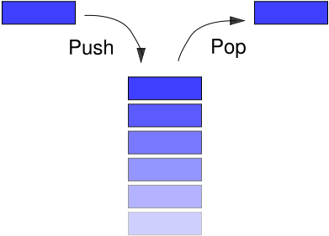
Stack and Stack-based Computer System
Temporary abstract data type
Last in First Out (LIFO)
Used extensively in modern computer systems
  Basic design of an operating system (interrupt handling and operating system function calls)
Two operations
  Push
  Pop

Slide 30
Function Call Stacks and Activation Records
Function call stack
  Sometimes called the program execution stack
  Supports the function call/return mechanism
    Each time a function calls another function, a stack frame (also known as an activation record) is pushed onto the stack
      Maintains the return address that the called function needs to return to the calling function
      Contains automatic variables—parameters and any local variables the function declares
  When the called function returns
    Stack frame for the function call is popped
    Control transfers to the return address in the popped stack frame
  If a function makes a call to another function
    Stack frame for the new function call is simply pushed onto the call stack
    Return address required by the newly called function to return to its caller is now located at the top of the stack.
  Stack overflow
    Error occurs when more function calls occur than can have their activation records stored on the function call stack (due to memory limitations)

Slide 31
Demonstration of Function Call Stack and Activation Records
int square(int ); //prototype for function square
int main()
{
int a = 10; //local automatic variable in main
cout << a << “ square: “ << square(a) << endl;
return 0;
}
int square (int x) // x is a local variable
{
return x*x; //calculate square and return result
}

Slide 32
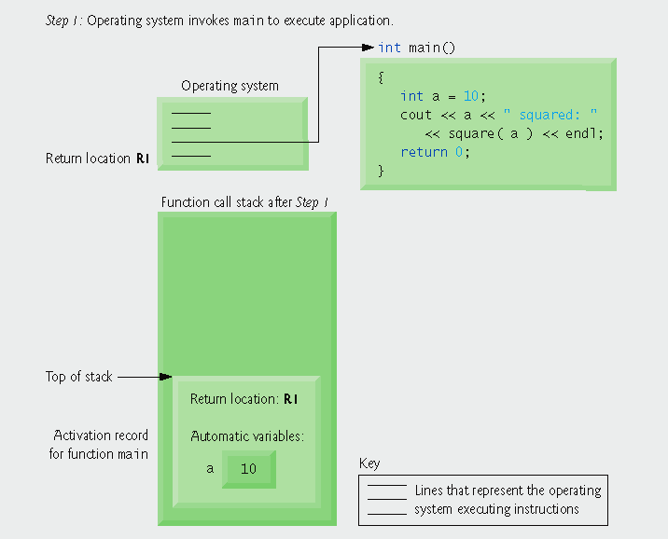
Function Call Stack (step 1)
Notes:
Operating system calls main, pushing an activation record onto the stack

Slide 33
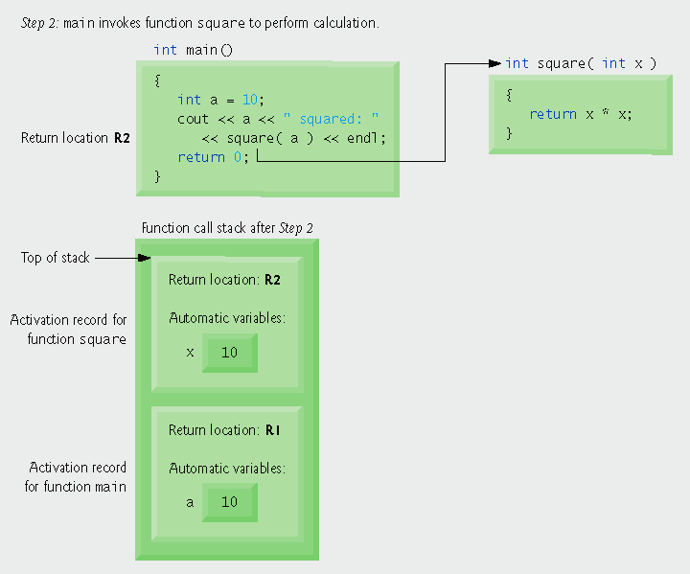
Function Call Stack (Step 2)
Notes:
Main calls function square, pushing another stack frame onto the function call stack.

Slide 34
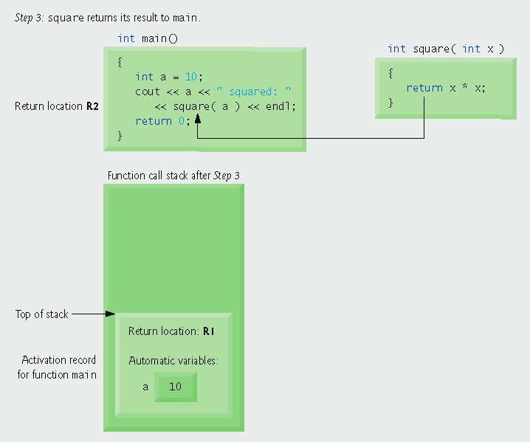
Function Call Stack (step 3)
Notes:
Program control returns to main and square’s stack frame is popped off

Slide 35
Functions with Empty Parameter Lists
Empty parameter list
  Specified by writing either void or nothing at all in parentheses
  For example,
  void print();
  void print(void);
  specifies that function print does not take arguments and does not return a value

Slide 36
Portability Tip
The meaning of an empty function parameter list in C++ is dramatically different than in C. In C, it means all argument checking is disabled (i.e., the function call can pass any arguments it wants). In C++, it means that the function explicitly takes no arguments. Thus, C programs using this feature might cause compilation errors when compiled in C++.

Slide 37
Inline Functions
Reduce function call overhead—especially for small functions
Qualifier inline before a function’s return type in the function definition
  “Advises” the compiler to generate a copy of the function’s code in place (when appropriate) to avoid a function call
Trade-off of inline functions
  Multiple copies of the function code are inserted in the program (often making the program larger)
  inline qualifier should be used only with small, frequently used functions
The compiler can ignore the inline qualifier and typically does so for all but the smallest functions
Any change to an inline function could require all clients of the function to be recompiled. This can be significant in some program development and maintenance situations.
Notes:
Inline reduces execution time, increase program size

Slide 38
Inline Example
/* Definition of inline function cube. Definition of function cube appears before is called, so a function prototype is not required. First line of function definition acts as the prototype
*/
inline double cube(const double side)
{
return side*side*side;
}
int main()
{
double sidevalue;
cout << “enter the side length of your cube: “;
cin >> sidevalue;
cout << “volume of cube with side “ << sidevalue
<< “ is “ << cube(sidevalue) << endl;
return 0;
}
Notes:
Cube function could be inline (may not be inline if compiler ignores it)

Slide 39
Passing Arguments to Functions
  Pass-by-value
    A copy of the argument’s value is passed to the called function
      Copying data can take a considerable amount of execution time and memory space for large data item
    Changes to the copy do not affect the original variable’s value in the caller
      Prevents accidental side effects of functions
  Pass-by-reference
    Gives called function the ability to access and modify the caller’s argument data directly

Slide 40
Reference Parameters and Pass-by-Reference
Reference parameters
  An alias for its corresponding argument in a function call
  & placed after the parameter type in the function prototype and function header
  Example
    int &count in a function header
      Pronounced as “count is a reference to an int”
  Parameter name in the body of the called function actually refers to the original variable in the calling function
Pass-by-reference
  Good: eliminate the pass-by-value overhead of copying large amounts of data.
  Bad: can weaken security, because the called function can corrupt the caller’s data.
  Preventing bad things: use constant reference parameter

Slide 41
Software Engineering Observation
For the combined reasons of clarity and performance, many C++ programmers prefer that modifiable arguments be passed to functions by using pointers (which we study in Chapter 8), small nonmodifiable arguments be passed by value and large nonmodifiable arguments be passed to functions by using constant references.
Notes:
Large data item such as class objects

Slide 42
Example of Pass-by-Reference
int squareByValue(int ); //function prototype (pass-by-value)
void squareByReference(int &); //function prototype (pass-by-reference)
int main()
{
int x = 2;
int z = 4;
cout << “x = “ << x << “ before squareByValue\n”;
cout << “value returned by squareByValue: “
<< squareByValue(x) << endl;
cout << “After squareByValue x = “ << x << endl;
cout << “z= “ << z << “ before squareByReference\n”;
squareByReference(z);
cout << “After squareByReference z = “ << z << endl;
return 0;
}
int squareByValue(int number)
{
return number *= number;
}
void squareByReference(int & numberRef)
{
numberRef *= numberRef; //caller’s argument modified
}

Slide 43
Reference and Reference Parameters (cont’)
References
  Can also be used as aliases for other variables within a function
    All operations supposedly performed on the alias (i.e., the reference) are actually performed on the original variable
    An alias is simply another name for the original variable
    Must be initialized in their declarations
      Cannot be reassigned afterwards
  Example
    int count = 1;
    int &cRef = count;
    cRef++;
      Increments count through alias cRef

Slide 44
Alias Example
int main()
{
int x = 3;
// int &y; is an error because reference must be initialized
int &y = x; // y refers to x (is an alias for) x
cout << “x = “ << x << endl;
cout << “y = “ << y << endl;
y = 7; //actually modifies x
cout << “x = “ << x << endl;
cout << “y = “ << y << endl;
return 0;
}
Notes:
Note: it is an error

Slide 45
Returning a Reference from a Function
  Functions can return references to variables
    Should only be used when the variable is static
  Dangling reference
    Returning a reference to an automatic variable
      That variable no longer exists after the function ends
    It is a logic error (some compiler may issue a warning)

Slide 46
Default Arguments
  A default value to be passed to a parameter
    Used when the function call does not specify an argument for that parameter
    Simplify writing function calls
    Changing default values require recompiling all client code (that use the function)
  Must be the rightmost argument(s) in a function’s parameter list
  Should be specified with the first occurrence of the function name
    Typically the function prototype
    It is a compilation error to specify default arguments in both a function’s prototype and header.

Slide 47
Example of Using Default Arguments
int boxVolume(int length=1, int width=1, int height = 1);
int main()
{
cout << “The default box volume is: “ << boxVolume();
cout << “\nThe volume of a box with length 10 and default width and “
<< “height is: “ << boxVolume(10);
cout << “\nThe volume of a box with length 10, width 5 “
<< “and default height is: “ << boxVolume(10, 5);
cout << “\nThe volume of a box with length 10, width 5, and height 2 “
<< “is: “ << boxVolume(10, 5, 2) << endl;
return 0;
}
int boxVolume(int length, int width, int height)
{
return length*width*height;
}

Slide 48
Unary Scope Resolution Operator
  Used to access a global variable when a local variable of the same name is in scope
  Cannot be used to access a local variable of the same name in an outer block
  It is an error to attempt to use the unary scope resolution operator (::) to access a nonglobal variable in an outer block
  Always using the unary scope resolution operator (::) to refer to global variables makes programs easier to read and understand, and help eliminate logic errors (e.g., a non-global variable hides global variable)

Slide 49
Example: Using Unary Resolution Operator
int number = 7; // global variable named number
int main()
{
double number = 10.5; // local variable also named number
cout << “Local double value of number = “ << number
<< “\nGlobal int value of number = “ << ::number << endl;
return 0;
}

Slide 50
Function Overloading
  Overloaded functions have
    Same name
    Different sets of parameters
  Compiler selects proper function to execute based on number, types and order of arguments in the function call
  Commonly used to create several functions of the same name that perform similar tasks, but on different data types
  Overloading functions that perform closely related tasks can make programs more readable and understandable.

Slide 51
Example of Function Overloading
int square(int x)
{
cout << “Square of integer “ << x << “ is “;
return x*x;
}
double square(double y)
{
cout << “Square of double “ << y << “ is “;
return y*y;
}
int main()
{
cout << square(7); // calls int version
cout << endl;
cout << square(7.5); // calls double version
cout << endl;
return 0;
}

Slide 52
How Compiler Differentiates Overloaded Functions
  Overloaded functions are distinguished by their signatures
    Creating overloaded functions with identical parameter lists and different return types is a compilation error.
  Name mangling or name decoration
    Compiler encodes each function identifier with the number and types of its parameters to enable type-safe linkage
  Type-safe linkage ensures that
    Proper overloaded function is called
    Types of the arguments conform to types of the parameters

Slide 53
Function Templates
  More compact and convenient form of overloading
    Identical program logic and operations for each data type
  Function template definition
    Written by programmer once
    Essentially defines a whole family of overloaded functions
    Begins with the template keyword
    Contains template parameter list of formal type parameters for the function template enclosed in angle brackets (<>)
    Formal type parameters
      Preceded by keyword typename or keyword class
      Placeholders for fundamental types or user-defined types

Slide 54
Function Template Specializations
  Generated automatically by the compiler to handle each type of call to the function template
  Example for function template max with type parameter T called with int arguments
    Compiler detects a max invocation in the program code
    int is substituted for T throughout the template definition
    This produces function-template specialization max< int >

Slide 55
Example of a Function Template
Using formal type parameter T in place of data type
//Definition of function template maximum
template <class T> //template <typename T>
T maximum(T value1, T value2, T value3)
{
T maximumValue = value1; //assumes value1 is maximum
//replace maximumValue with value2 is value2 is larger
if (value2 > maximumValue)
maximumValue = value2;
//replace maximumValue with value3 is value3 is larger
if (value3 > maximumValue)
maximumValue = value3;
return maximumValue;
}// end function template maximum

Slide 56
Using Function Template
int main()
{
int int1, int2, int3;
cout << “Input three integer values: “;
cin >> int1 >> int2 >> int3;
//invoke int version of maximum
cout << “The maximum integer value is: “
<< maximum(int1, int2, int3);
//Demonstrate maximum with double values
double double1, double2, double3;
cout << “\n\nInput three double values: “;
cin >> double1 >> double2 >> double3;
cout << “The maximum double value is: “
<< maximum(double1, double2, double3);
char char1, char2, char3;
cout << “\n\nInput three characters: “;
cin >> char1 >> char2 >> char3;
//invoke char version of maximum
cout << “The maximum character value is: “
<< maximum(char1, char2, char3) << endl;
return 0;
}

Slide 57
Recursion
Recursive function
  A function that calls itself
Recursion
  Base case(s)
    Function knows how to handle
  For all other cases, the function divides the problem into two conceptual pieces
    A piece that function knows how to do
    A piece that it does not know how to do
      Slightly smaller version of the original problem
  Recursive call
    The function launches a fresh copy of itself to work on the smaller problem
    The sequence of smaller and smaller problems must eventually converge on one of the base case(s)
      Otherwise the recursion will continue forever

Slide 58
Factorial: An Example of Recursion
Factorial function
  n! = n(n-1)(n-2)…1
  1! = 1, 0!=1
Recursive definition of the factorial function
  n! = n(n-1)!
  Example
      5! = 5 · 4 · 3 · 2 · 1
      5! = 5 · ( 4 · 3 · 2 · 1)
      5! = 5 · ( 4! )

Slide 59
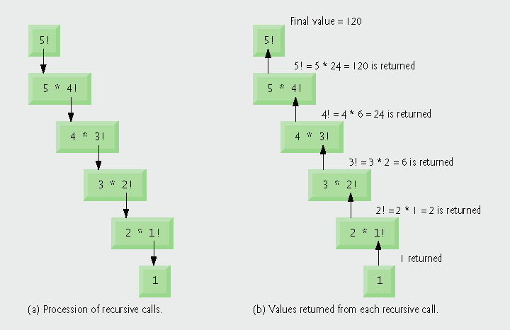
Recursive Evaluation of 5!

Slide 60
Recursive Factorial Function
#include <iostream>
#include <iomanip>
using namespace std;
unsigned long factorial(unsigned long);
int main()
{
for(int counter=0; counter<=10; counter++)
cout << setw(2) << counter << “!=“
<< factorial(counter) << endl;
return 0;
}
unsigned long factorial(unsigned long n)
{
if (n <= 1) //test for base case
return 1; //base cases 0!=1 1!=1
else //recursive step calls itself with a smaller problem
return n*factorial(n-1);
}

Slide 61
Infinite Recursion
Causes
    Omitting the base case
    Incorrect recursive step such that it does not converge on the base case
Results
    Exhausting memory
    Analogous to an infinite loop in an iterative (non-recursive) solution

Slide 62
Example Using Recursion: Fibonacci Series
The Fibonacci series
  0, 1, 1, 2, 3, 5, 8, 13, 21, …
  Begins with 0 and 1
  Each subsequent Fibonacci number is the sum of the previous two Fibonacci numbers
  can be defined recursively as follows:
    fibonacci(0) = 0
    fibonacci(1) = 1
    fibonacci(n) = fibonacci(n – 1) + fibonacci(n – 2)

Slide 63
Recursive Fibonacci Function
#include <iostream>
using namespace std;
unsigned long fibonacci(unsigned long);
int main()
{
for(int counter=0; counter<=10; counter++)
cout << “fibonacci(” << counter <<“)=“
<< fibonacci(counter) << endl;
return 0;
}
unsigned long fibonacci(unsigned long n)
{
if ((n==0) || (n==1))
return n; //base cases
else //recursive step calls itself with a smaller problem
return fibonacci(n-1)+fibonacci(n-2);
}

Slide 64
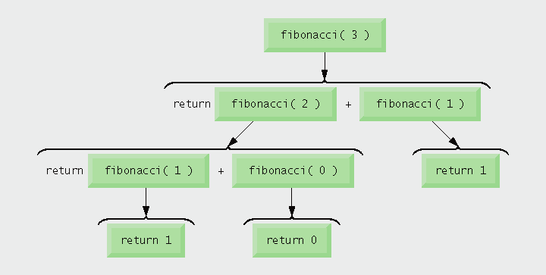
Set of Recursive Calls to Function fibonacci

Slide 65
Recursive Fibonacci Function Leads to
Exponential “Explosion” of Calls
Each level of recursion in function fibonacci has a doubling effect on the number of function calls
  i.e., the number of recursive calls that are required to calculate the nth Fibonacci number is on the order of 2^{n}
  20th Fibonacci number would require on the order of 2²⁰ or about a million calls
  30th Fibonacci number would require on the order of 2³⁰ or about a billion calls.
Exponential complexity
    Can humble even the world’s most powerful computers
Performance tip
  Avoid Fibonacci-style recursive programs

Slide 66
Recursion vs. Iteration
Both are based on a control statement
    Iteration – repetition structure
    Recursion – selection structure
Both involve repetition
    Iteration – explicitly uses repetition structure
    Recursion – repeated function calls
Both involve a termination test
    Iteration – loop-termination test
    Recursion – base case
Both gradually approach termination
    Iteration modifies counter until loop-termination test fails
    Recursion produces progressively simpler versions of problem

Slide 67
Recursion vs. Iteration (Cont.)
Both can occur infinitely
    Iteration – if loop-continuation condition never fails
    Recursion – if recursion step does not simplify the problem
Negatives of recursion
    Overhead of repeated function calls
      Can be expensive in both processor time and memory space
    Each recursive call causes another copy of the function (actually only the function’s variables) to be created
    Can consume considerable memory
Iteration
    Normally occurs within a function
    Overhead of repeated function calls and extra memory assignment is omitted
Any problem that can be solved recursively can also be solved iteratively (non-recursively)

Slide 68
When to Use Recursion
Recursive approach mirrors the problem more naturally
  Program is easier to understand and debug
An iterative solution is not apparent

